Slide 1
Metering Overview
Shikha Srivastava
ssriva@us.ibm.com

Slide 2

Metering in Private cloud
Kubernetes Metrics
IBM Cloud private platform is based on Kubernetes and helps clients build, deploy and manage containers on-premises
IBM Cloud private platform is licensed by Virtual Processor Cores (VPCs)both for the platform itself, as well as the IBM product content running in the cloud.
  Metering will be used to help the customer understand their total vCPUs used (for the platform) and available/used/capped vCPUs for any content running in the platform.
  This will also be viewable as aggregated by Kubernetes namespace so that IT can charge back to application teams by namespace for the workloads they are running.
  Feature spec @ https://github.ibm.com/IBMPrivateCloud/roadmap/blob/master/feature-specs/Usage-Metering.md
Cluster
Node
Node
Pod
Pod
Pod
Pod
= 1 Container
Key Kubernetes Licensing metrics
Node | Individual VMs (1 VM = 1 Node); defined by CPU/VPC allocation
Cluster | 1 or more Node; also can be referred to as an instance
Other Kubernetes metrics you might hear from customers
Pod | A group of one more containers that are tightly coupled and share the same compute, networking, and storage
App Instance (AI) | Abstracts technology, but hard to define. Typically, 1 container will host either 1 AI or a part of an AI
Container | A Docker image runtime
# of VPCs
(or vCPUs)
Price for IBM Cloud private platform
=
Licensed monthly or perpetual
Notes:
How do we get on the platform? Need to get charts that show this

Slide 3
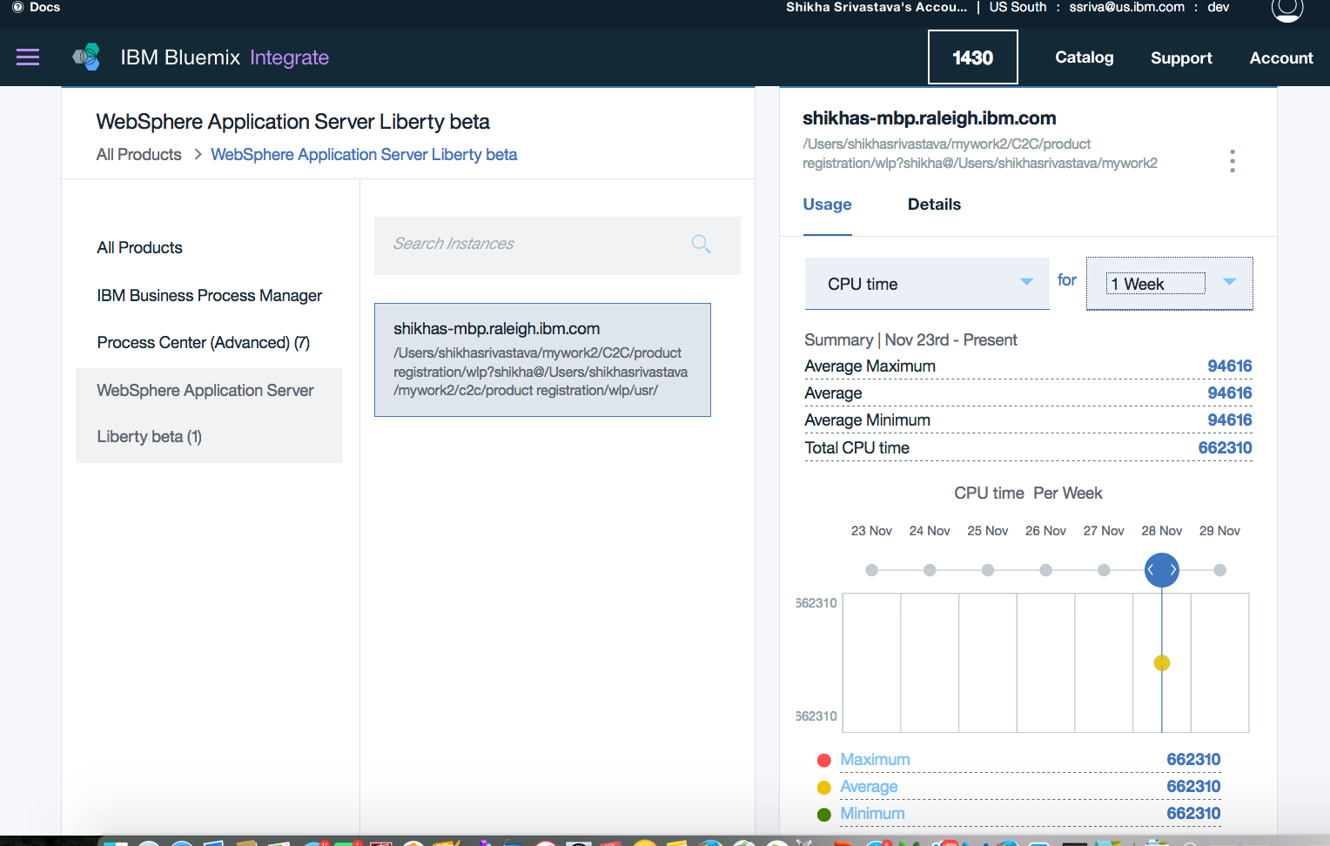
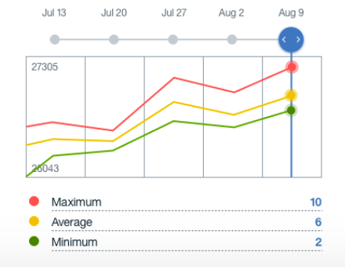
Metering: How it works in ICP
Kernetes metric data collection
IBM Private Cloud platform & workloads is metered through daemonset running in ICP cluster and sent to the metering service (API server)
Licensing will be based on vCore metrics (available/used/capped cores) which is collected form the K8S or Docker system(s)
IBM Product ID is the label in the container. IBM Billing plan is identified by a label in the Pod in which the container is running (and configurable in the helm document when deployed)
Containerized products in ICP may send other information to PI if they want to license on other criteria (in the future)
Node(s)
Pod(s)
Container Label identifies
Product ID (from ILMT ISO file)
IBM Middleware
(Container)
POD Label identifies Metering Plan.
Specified in Helm Chart
(or Service Broker if used)
Defaulted if not Specified
Metering UI
(Product Insights)
Daemonset Pod
Gathers label and
runtime data
Identifies start/stop
& utilization metrics, e.g.:
CPU (cores)
Memory
Pod(s)
Pod(s)
Kublet (cAdvisor)
Heapster
K8s APIs
Docker APIs
K8s watch
Metering Service
(API Server)
Aggregator,
Usage report and forwarding
Metering DB
BSS

Slide 4
Metering in ICP: Usage report
Green items targeted for Oct GA
The usage report will allow the customer to group information in different ways, but the following elements will be included.
ICp Cluster Instance name
Start date/time, Stop Date/time (time for which the following metrics were seen)
Node name/IP (For base ICp platform metrics only)
K8s NameSpace (for Workloads - e.g. WAS, MQ, DB2, etc)
Resource Type Identification:
  Helm Chart Name/ Version
  Helm Release Name
  Pod Names
  Container name
  IBM product name
  IBM Product Id
  IBM Product Version
  IBM (billing) plan ( future)
Measured metrics (vCores available, capped cores, average used cores, max concurrent cores at any instant, Memor)

